Slide 1



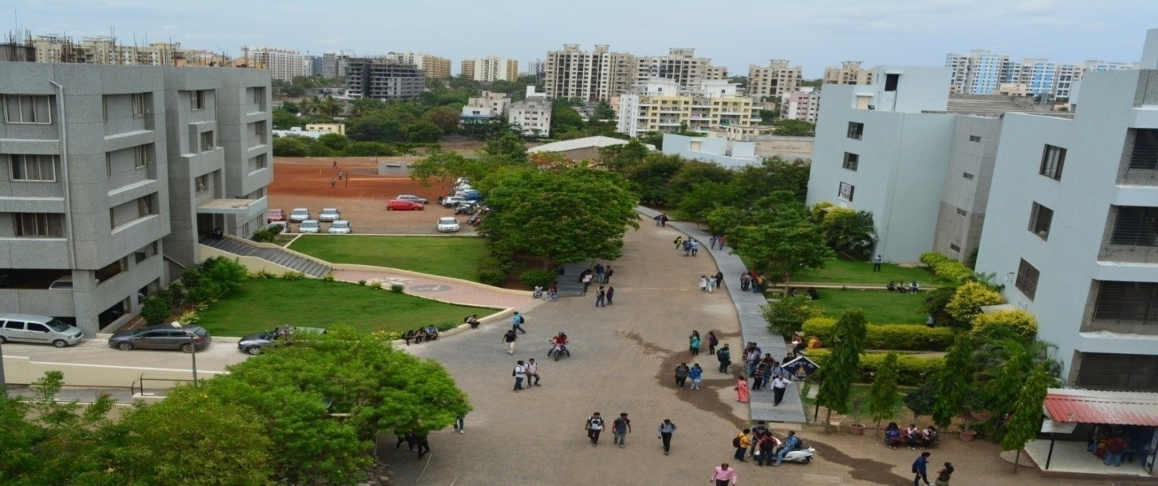
Bansilal Ramnath Agarwal Charitable Trust’s Vishwakarma Institute of Information Technology, Pune
Department of AI & DS

Slide 2
GROUP MEMBERS
Sr No. | NAME | ROLL No.
1. | Siddhesh Khairnar | 28
2. | Prajwal Mapari | 31
3. | Atharva Nandurkar | 38
4. | Pushkar Patil | 42

Slide 3

PROBABILITY AND
STATISTICS
PBL
LOAN ELIGIBILITY USING MACHINE LEARNING MODELS

Slide 4

KEY FEATURES
EDA​
Understanding the data​
Missing value and outlier treatment​
Data Visualization​
Seaborn​
Matplotlib ​
Model building​
Logistic Regression Multiclass​
Cross val score​
Another model for the comparison​
Execution Plan​
Collecting insights​
Problems solving using ML model​

Slide 5

Software Requirements
Operating System
Web Browser
Kaggle
Google Collab

Slide 6
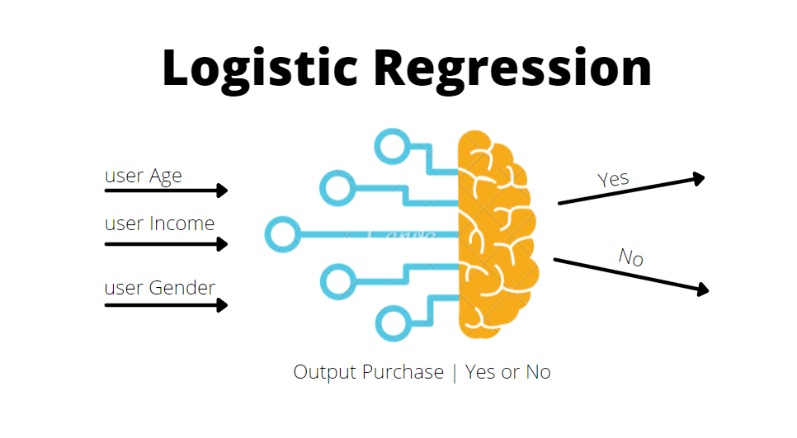
Logestic Regression
Logestic Regression is a base line ML model build over Linear regressor.
Logestic Regressor Implements same statistical methods used by Linear Regressor with passing on the output variable with Sigmoid Function

Slide 7
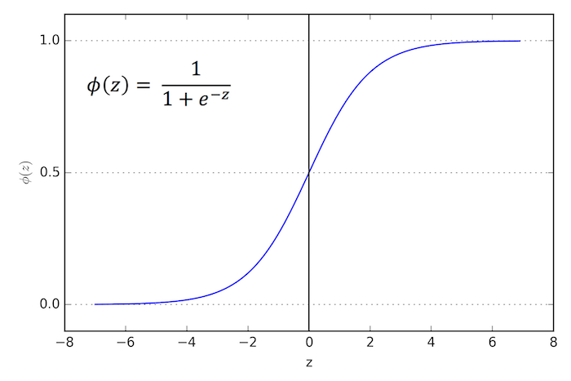
What is a sigmoid function?
The logistic function in linear regression is a type of sigmoid, a class of functions with the same specific properties. Sigmoid is a mathematical function that takes any real number and maps it to a probability between 1 and 0.

Slide 8
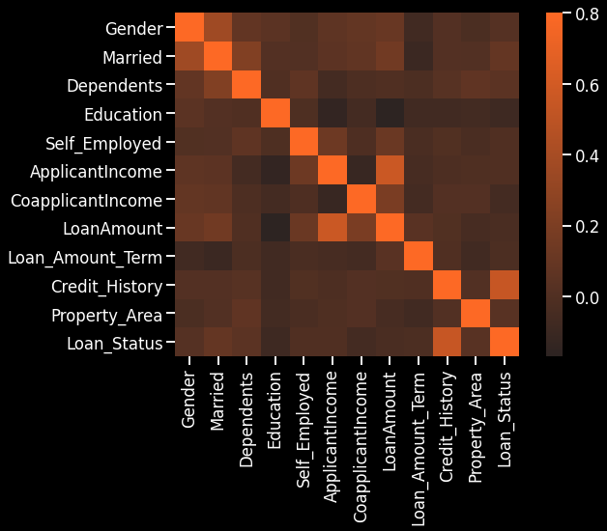
EDA :
Correlation Heat Map

Slide 9
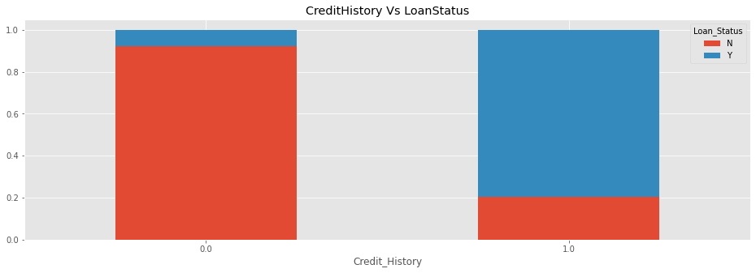
EDA :
Credit History Vs Loan Status

Slide 10
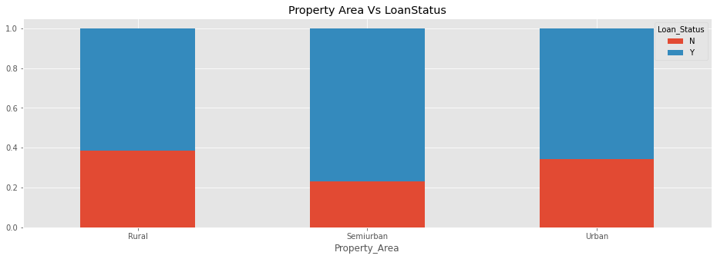
EDA :
Credit History Vs Loan Status

Slide 11
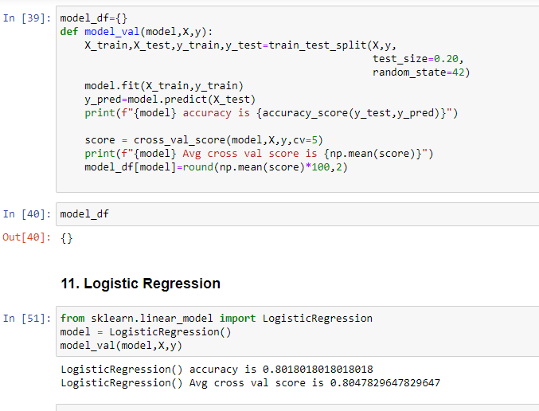
Code Snippet :

Slide 12
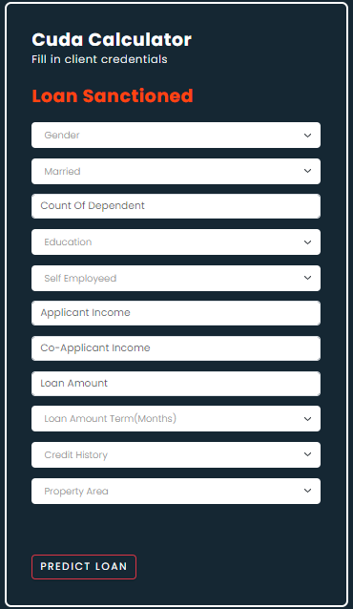

Output :

Slide 13

Applicability
This product will not only be useful in load industry but also is highly scalable in any sort of risk encountering industry.
In collaboration with human observation , this product might turn out to be a game changer in the industry with minimizing the probabilities of loss .
Banks can use this product to cluster customers in different bubbles and thus helping banks to find perfect customer for different loan brackets.

Slide 14

References
https://www.ibm.com/topics/linear-regression#:~:text=Resources-,What%20is%20linear%20regression%3F,is%20called%20the%20independent%20variable.
https://www.javatpoint.com/logistic-regression-in-machine-learning
Research papers:
https://www.researchgate.net/publication/308007227_Exploratory_Data_Analysis
https://www.researchgate.net/profile/Joanne-Peng-4/publication/242579096_An_Introduction_to_Logistic_Regression_Analysis_and_Reporting/links/0deec5374c228b7fa1000000/An-Introduction-to-Logistic-Regression-Analysis-and-Reporting.pdf

Slide 15
Research Paper References
1. Chitra, K., and B. Subashini. "Data Mining Techniques and its Applications in Banking Sector."
2. Zurada, Jozef, and Martin Zurada. "How Secure Are “Good Loans”: Validating Loan-Granting
3. Seltman HJ (2012) Experimental design and analysis. Online https://www.stat.cmu.edu/~hseltman/309/Book/Book.pdf
4. Cabrera, A. F. (1994). Logistic regression analysis in higher education: An applied perspective. Higher Education: Handbook of Theory and Research, Vol. 10, 225–256. Chuang, H. L. (1997).

Slide 16


